Slide 1
Olave 2019 International Camp
Saturday 27th July – Saturday 3rd August 2019
Celebrating 30 years
Notes:
Those who led Sussex East in 1987, were forward looking and innovative, in those days International camps were not common, and Sussex East was one of the first counties to take that big step and offer such a fantastic opportunity for Girls. One of the reasons this happened was that Olave BP had been a Commissioner in Sussex and 1989 would be the centenary of her birth. Hence the name of our first International camp Olave ‘89.
Each Olave camp has been unique, each has added new activities and faced new challenges. In 2019 all the Guides and Senior Section members on site will have been born since the year 2000. Our Challenge 30 years on is to offer an equally forward looking and innovative opportunity for 21st century girls and young women.

Slide 2
Olave 2019 - Objectives
Unique and new experiences.
A bigger adventure – different and exciting challenges.
Making new friendships – which could last a lifetime.
Take part in new activities - for some that will be where and what they are sleeping in.
An international camp – a memorable experience where everyone involved - girls, young women and adults - have a great time.
A chance for girls that attended previous Olave camps to be leaders this time.
Notes:
We’ve already met with lots of Guides and Leaders to find out what they are looking for, what they want from the camp this time. As a result of the consultation and have your say events we have a set of objectives.
The last two are significant – we need to ensure our adults have a good time and we need to provide opportunities for younger leaders to be part of the team.

Slide 3
Olave 2019
Girlguiding Sussex East County is fortunate to be able
to offer this opportunity to all girls and young women.
An International experience that takes place every four to five years which is open to all.
A celebration of all that makes Sussex so special.
Why would your Unit miss out?
Notes:
Once Guides have attended an international camp they often go on to bigger things, travelling abroad as part of a county group, taking up a sport or hobby they tried at camp or joining an international service crew and volunteering at a camp overseas – the possibilities are endless. Senior Section members who were at Olave 2015 as Guides need different experience something extra and we will be talking to Senior section groups in order to develop the programme for the senior section.
At the Have Your Say day Guides told us that some girls aren’t sure about camping, we need to make sure they know that International camp is different – yes we sleep in tents but there is a whole village built especially for us, our meals are provided in a massive dining marquee and there is no washing up. There is lots of choice of activities and lots to do in the evenings as well as during the day.

Slide 4
Olave 2019 – Programme Theme
Olave 2019 Pearl
Treasure Island – fantasy and fantastical.
Get on Board – adventure day with a choice of activities – you will decide before arriving at camp.
All at sea – boating or water activities plus science and craft. Caring for the oceans.
Also included is a Sussex day out, camp open day and a chill out time to relax and pamper yourself.
Notes:
Our programme theme revolves around Pearls – Pearl being the celebration of 30 years.
We have ambitious plans to ensure our programme is relevant to all ages and interests with plenty of choice so that girls can make their own decisions.
The camp will include a huge range of activities over 6 days, building on previous camps but also adding some exciting new options. All that Blackland Farm can offer and much much more.
A full evening programme will include; a film night, camp fire, Olave’s got talent, crafts, a chill zone and bungie trampolines.

Slide 5
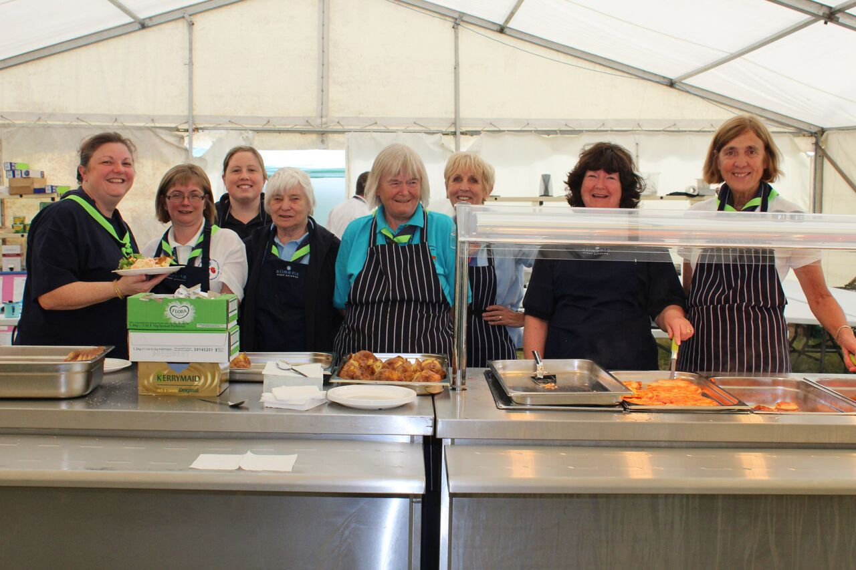
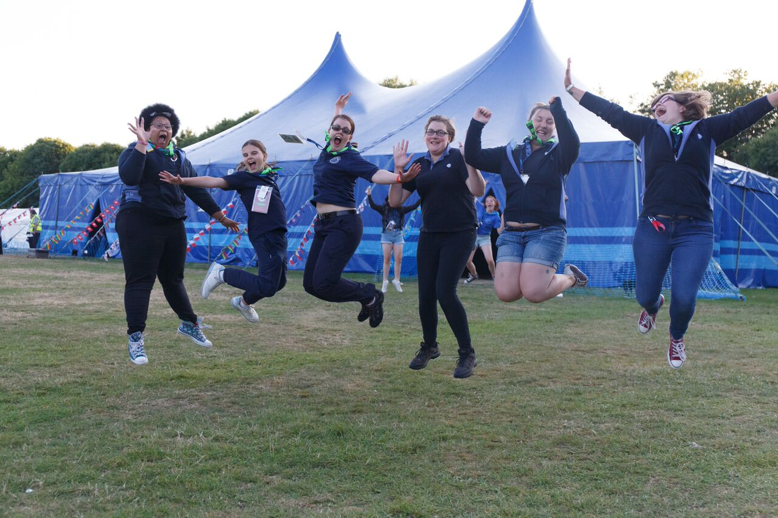
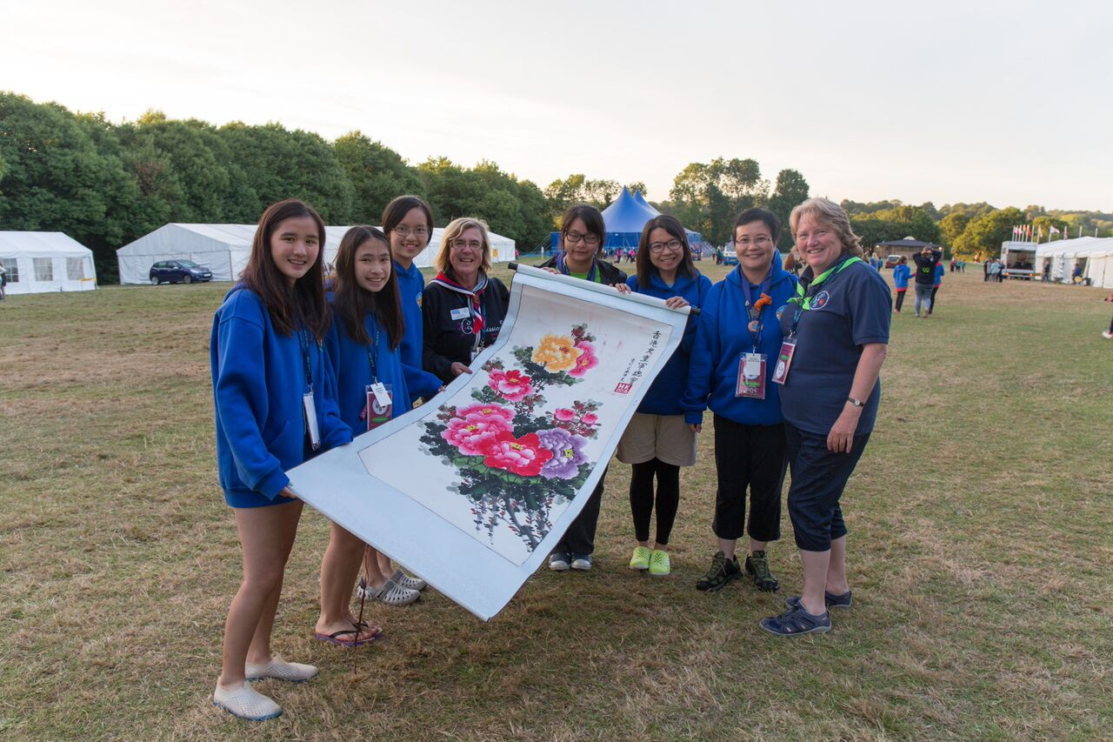
Olave 2019
Notes:
For many girls, an Olave Camp is the highlight not just for the year but for their whole time in Girlguiding.
For the 10 year olds it’s a bridge towards independence – a great stepping stone towards moving on to big school.
For older girls it’s a great opportunity to be with your friends and to meet girls from other counties, all in the safe all girl space that Girlguiding provides.
We need Divisions, Districts and Units to ensure all Guides have the opportunity to attend and that leaders from all sections know we’d like them to join us.

Slide 6
Olave 2019 - Fundraising
Many units, districts and divisions fundraise to help with the cost of the camp.
Share your fundraising experiences with others.
A list of fundraising ideas will be on the website.
www.olave.org.uk
Notes:
The fee for Sussex East girls is £20 less that for others and county has agreed to fund £40 of every girls fee, provided they meet all the payment deadlines. This means the amount our girls will pay is the same as in 2010.
We recognise this is still too much for some families. Lots of Units and Districts raise considerable amounts of money to ensure more girls can attend. Those Units in deprived areas can apply for funding from the Girlguiding Units in need fund.
There will also be a savings scheme available for those who find it easier to pay in instalments.

Slide 7
Olave 2019 – who is able to join us?
Girlguiding Sussex East County - leaders* and helpers.
Girlguiding Sussex East County - Trefoil Guild members.
Leaders & helpers from other counties in Girlguiding UK.
International Service Crew.
* A county grant is available to Sussex East Leaders
Notes:
So what about adults – leaders and volunteers?
I’m pleased to be able to tell you that members of the County Finance Committee suggested we also help Sussex East Leaders with the cost of their fee, again provided they meet the payment deadlines. The details are on the back of your leaflets.
We will also welcome adult members of WAGGGS from around the world as adults for our service crew. This is an international camp tradition, that works across the world, which we’ve not tapped into before. We hope this will enhance the international experience for Leaders and that we’ll have more pairs of hands to help reduce the workload.

Slide 8
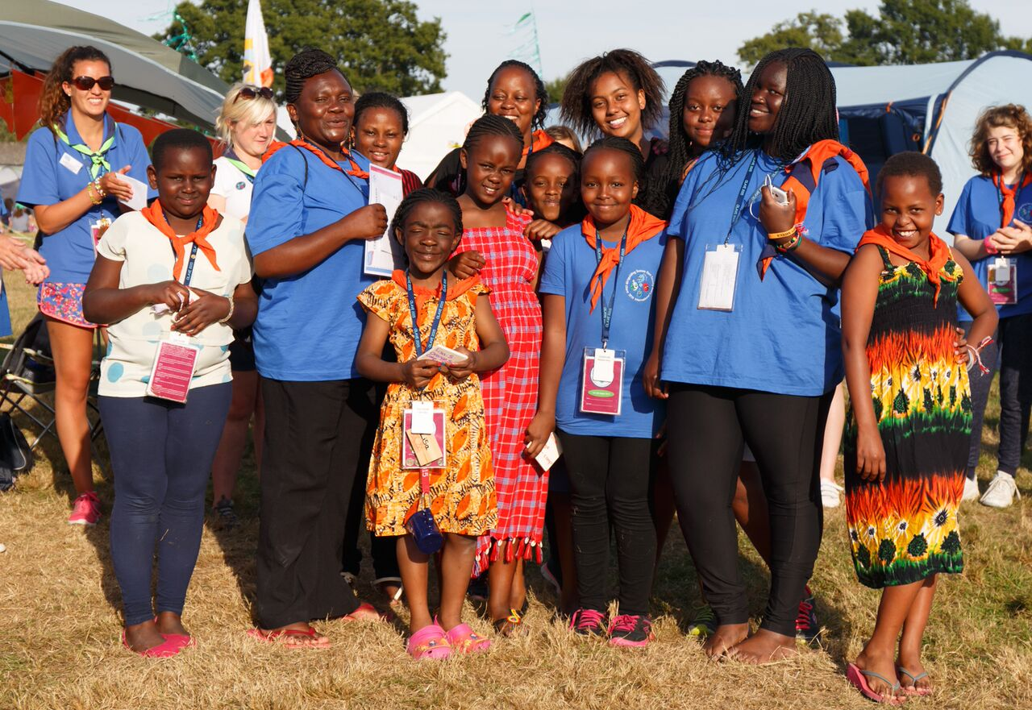
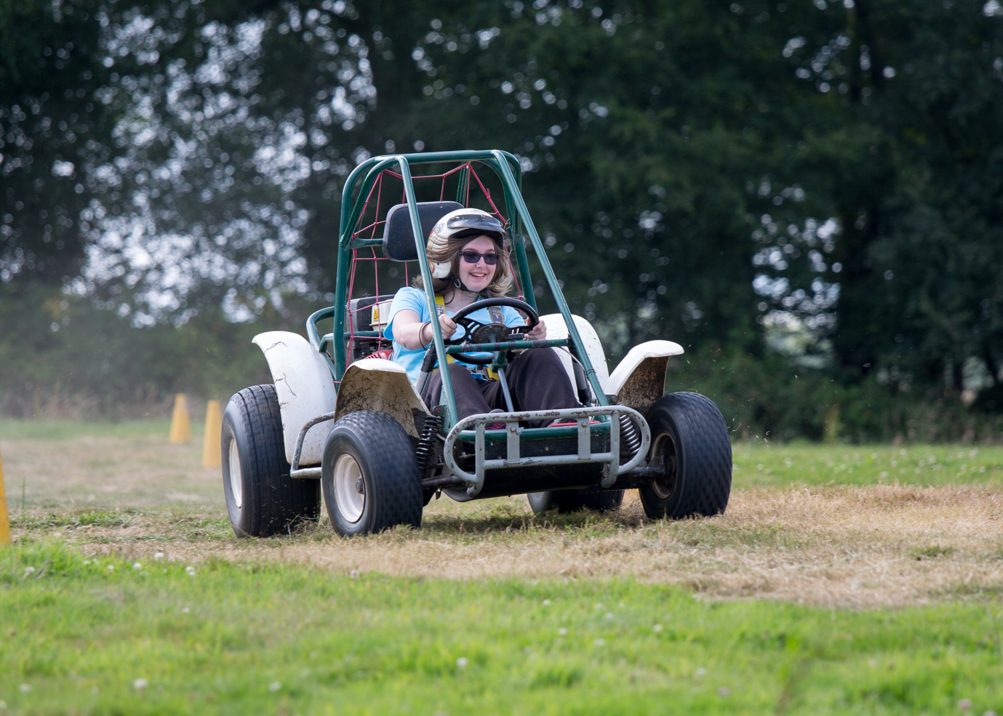
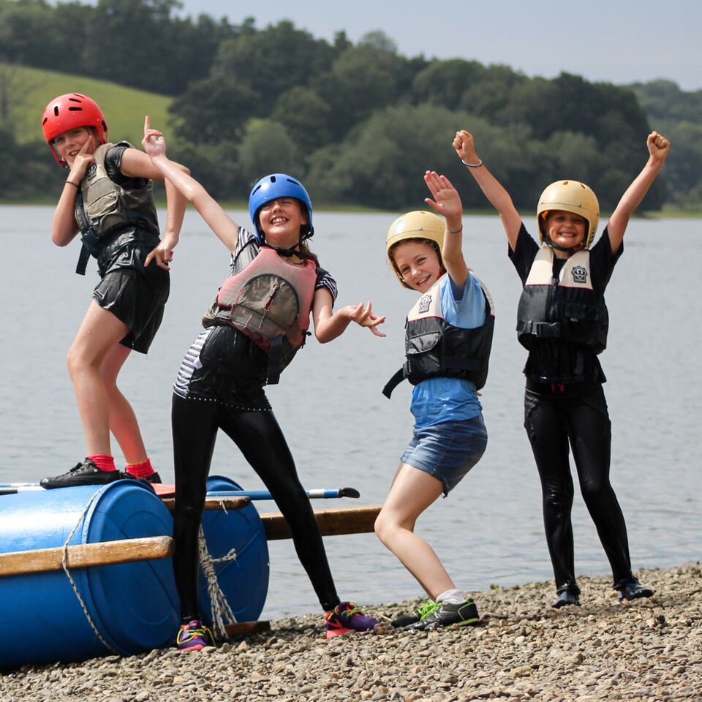
You can help make this happen ….
Notes:
The service crew isn’t just for International Leaders.
Its for our current and past leaders and helpers, Rainbow & Brownie Leaders, D of E participants etc.
They all have the opportunity to join Team Olave - either to do something specific –making macramé owls every night or serving breakfast every morning or they can volunteer for the service crew for a more varied week.

Slide 9
Olave 2019 – we need you!
To make sure that everyone has a great time, Olave 2019 needs you …
Guide & Senior Section leaders can camp on sub camps with their unit.
Other adults will camp on the Central sub camp along with the service crew. Members of WAGGGS (over 18 years) will be welcomed into the service crew.
Notes:
There will not be a fixed maximum number of leaders camping on sub camps – we’d like girls to be camping with the Leaders they know. Those leaders not part of the sub camp team will be volunteering in one of the other teams, we want all the teams to have some down time and to do this we need more volunteers.
We’d like you to contact those who’ve attended previous Olave camps, leaders who’ve moved away from Sussex, or those who are local but are not currently members and invite them to join the service crew.
Volunteering is trendy, lots of adults are looking to volunteer but are not able to be regular leaders – this could be the opportunity for them to see how Girlguiding has changed.

Slide 10
Olave 2019 – Leaders bringing children
There will be a professionally run crèche and play scheme for leaders own children, who will be under 10 years.
If leaders wish to bring own children over 10 years, who are not Guides, an opportunity can be created for a ‘young crew’ of part time helpers who also get to do some activities.
Notes:
Many county camps offer a crèche opportunity and this will also apply to Olave 2019 .
We have made a provisional booking and now need to know how many Leaders would take up this opportunity – or how many children this would be!
If you or one of your team would like more information please email the address on the back of the leaflet.

Slide 11
Olave 2019 – booking system
We will be using an online booking system which will open after the Easter holiday.
Group bookings can be made by Unit leaders or by someone in your District/Division to put together a group from several Units.
Unit leaders can delegate the booking to one of their team.
Notes:
The booking system for girls and adults is changing – and we’ve heard some people are concerned about this - but its time to move forward, we are one of the only camps still using a paper booking system and we need reduce the amount of paper.
Those Guide Units who’ve been to TAC – Training and Activity Centre – events such as Wellies & Wristbands or Sparkle and Ice, will be aware that these events have moved on and we need to change our systems and culture so that Olave 2019 is much more like these events.

Slide 12
Olave 2019 – advertising
The sales presentation will be available for you to download from the website and use.
A leaflet and parents letter will be provided for all Guide and Senior Section members.
A leaflet and parents letter will be provided for Brownies aged 9 and over.
Divisions will need to ensure that all Units have the opportunity to see the presentation.
Notes:
The leaflets are available. The parents letter will be loaded onto the website after Easter, we know many Units/ Districts/Divisions will want to amend the letter to add fundraising information etc.
But we will make standard letters available to those who want us to do the printing for them – and you can request that by emailing the address on the leaflet.
We need to ask Divisions to ensure everyone knows about Olave 2019 and that All Guides & Senior section members and their parents have had the opportunity to see the presentation. We hope that the website will enable those girls and parents who are not able to attend a presentation will view the power point slideshows online.

Slide 13
Olave 2019
Camp Fees
Data protection
All deposits need to be paid by the 31st July.
Further payments will be due in November 2018 and March 2019.
The data protection rules are changing and the camp team will be collecting as little information as possible until much nearer the camp. The initial booking should be a lot easier.
Notes:
You may have heard of GDPR?– The data protection rules are changing and we must reduce the amount of information we hold. So please don’t be concerned about having to load lots of information into the system.
Addresses for example won’t be collected until the health forms come in much nearer the camp.

Slide 14
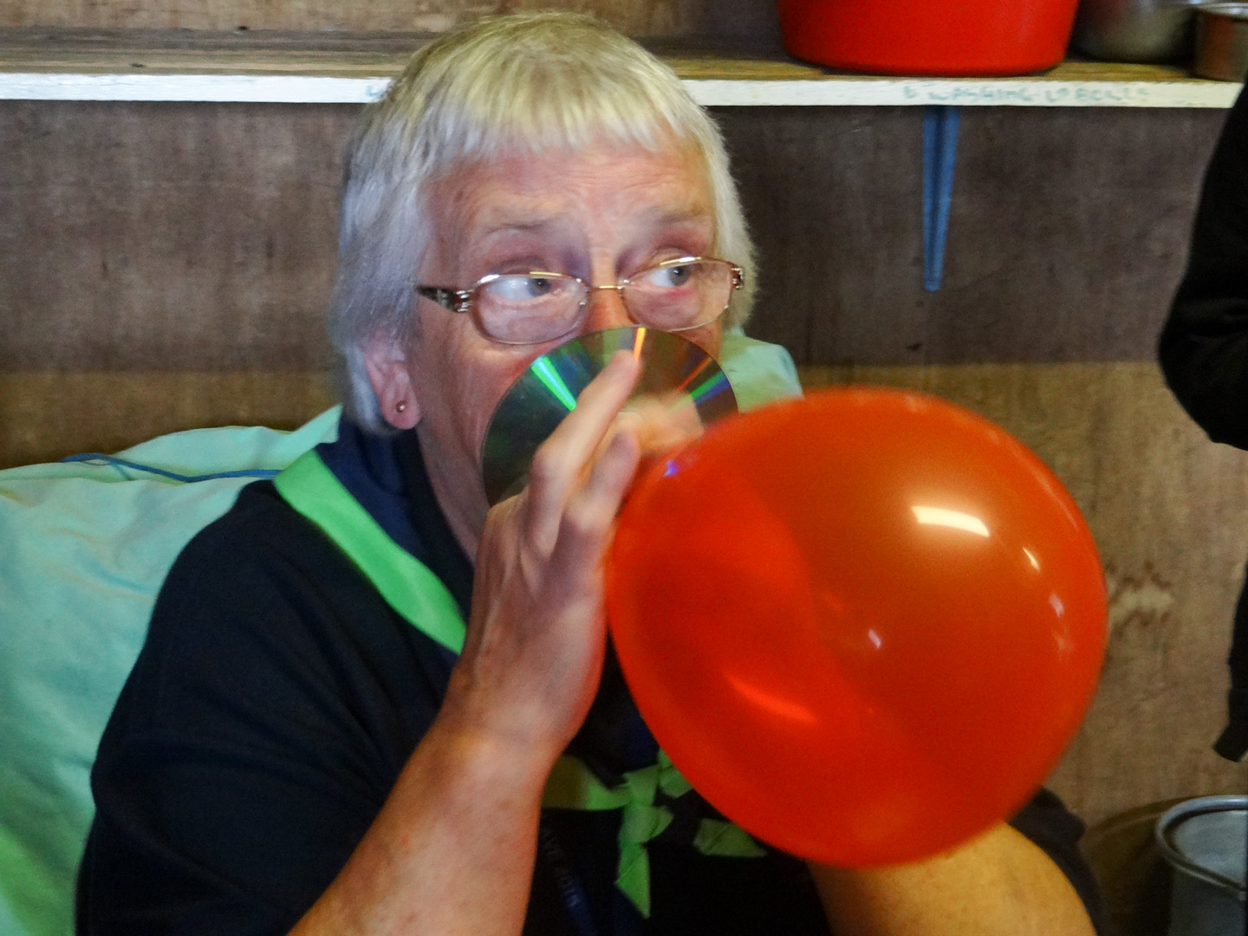
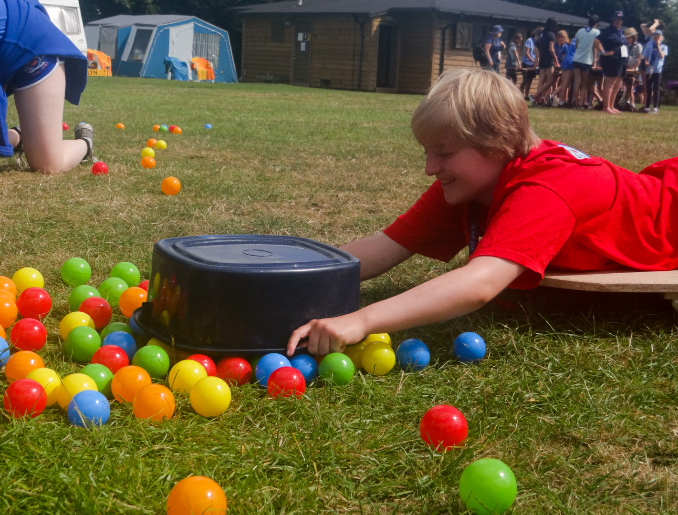
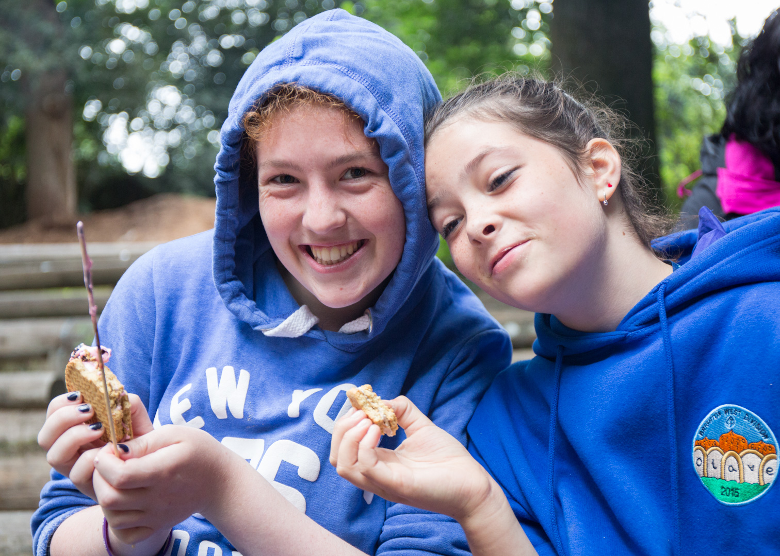
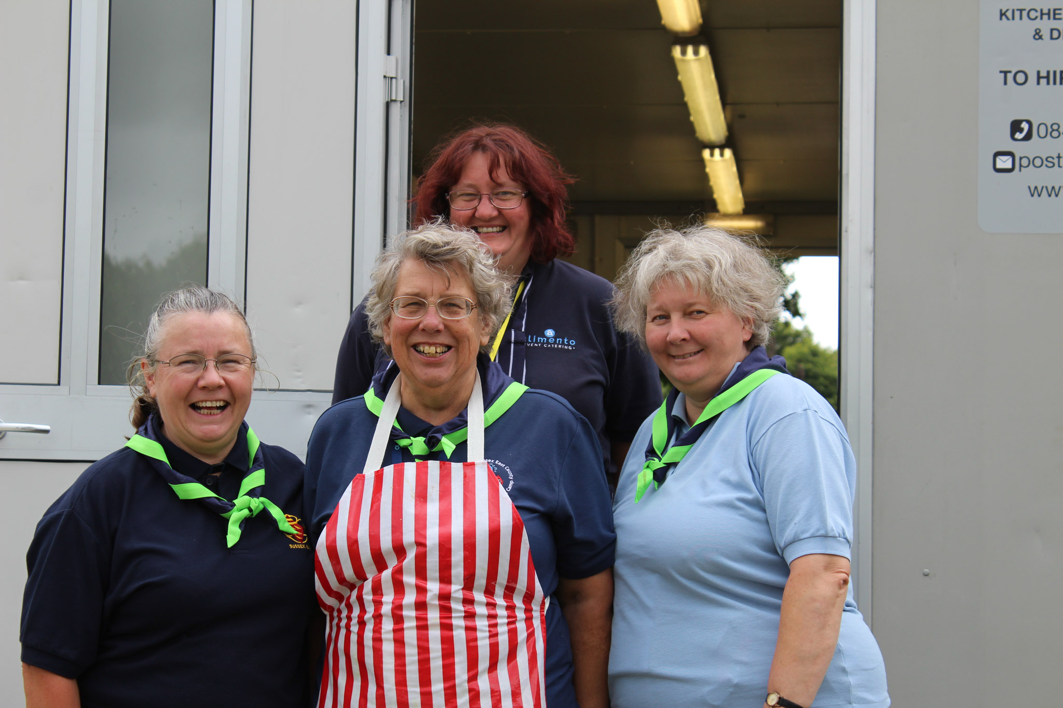
Olave 2019
Notes:
We need lots of volunteers to contribute their skills and interests.
There will be roles which will involve a just few weeks preparation – or are only for the week of the camp.
If you tell us your skills or what you’d like to do – it helps us not to put square pegs in round holes.

Slide 15
Olave 2019 – volunteer role vacancies
The camp will only work if lots of volunteers give their time and/or share their skills and interests.
If you would like to help in the planning and delivery of the camp please look out for the vacancies on the website.
If you would like to offer an activity or craft please contact the team by email on info@Olave2019
Notes:
We’d also like your knowledge – Seahaven Division emailed about a great activity they’d had at their World Thinking Day event. If you know a good activity provider please do pass on their details.

Slide 16
Olave 2019 – who we need!
Volunteers for …
Activity leaders/helpers
Escorts taking groups to activities
Catering staff
Dining room supervisors
Washing up machine operators
Interpreters
Security
Airport greeters
Set up team for two days before the camp
Close down team for the strike weekend.
Offsite teams for days out.
Notes:
We need both skills and pairs of hands.
The programme includes a day out in Sussex – we need two /maybe three seaside towns as venues (the SS could be somewhere different to the Guides) The teams running the days out wouldn’t need to be on camp if that was their
preference.
If you’re not free during the week – we will certainly need people on both the weekends.

Slide 17
Olave 2019 - Volunteers
Volunteers are welcome for the whole week, or a few days - camping or travelling daily.
We will need extra volunteers on Tuesday when we open the camp to Rainbows, Brownies and Guides from across the County.
If you would like to help in the kitchen, dining room, with activities or on security please complete an expression of interest form.
Notes:
After Olave 2015 we found out some Leaders didn’t realise you can volunteer for part of the week – or for one day!
And you don’t have to camp – if camping isn’t for you its ok to go home to your comfy bed and travel daily.
Booking for those who are not coming for the whole week will open in January, but don’t let that stop you from volunteering now so that we know you are interested.
Expression of interest forms are downloadable from the members area on the county website.

Slide 18
Olave 2019 Girlguiding Sussex East County International Camp
www.olave.org.uk
Looking forward to seeing you there!
Notes:
I hope this has given you an insight into the plans for Olave 2019; every Olave camp has been a fantastic experience, every Olave camp has been unique.
We’ll continue to offer girls choice, this time we plan to give adults some downtime and to share as much information ahead as possible. The notes from the management meetings, the programme and the menu will all be shared once they are agreed.
We will be using the website for updates newsletters etc. There will be an online group –for Team Olave to keep everyone in the loop and enable us to get your ideas and comments.
Thank you.

